Slide 1
Android PM,
Deadline(RM, EDF)
국민대학교 임베디드 연구실
경 주 현
2017 LG MC 인재육성팀 교육

Slide 2
Outline
Android PM
Deadline Scheduler

Slide 3
Android PM

Slide 4
Android PM
Android inherits the Linux PM
Wakelocks
Scheduling Wakeups
Early Suspend

Slide 5
Task may be blocked waiting on I/O
Problem:
Task may be blocked waiting on I/O
Ex) Weather application
Waiting for a response from the remote server

Slide 6
Wakelocks
Problem:
Task may be blocked waiting on I/O
Weather application
Waiting for a response from the remote server
Solution:
Android uses wakelock
Wakelock
While any wakelock is held the system does not suspend

Slide 7
Wakelock’s problem
Wakelock’s problem
CPU can not go to suspend.
High power consumption

Slide 8
Scheduling Wakeups
Wakelock’s problem
CPU can not go to suspend.
High power consumption
Solution
To allow applications to wake up at a specified time
Scheduling Wakeups

Slide 9
Scheduling Wakeups
To allow applications to wake up at a specified time
Android introduces wakeup alarms
/dev/alarm virtual device and AlarmManager
Set next alarm -> wake up

Slide 10
Wake-lock for kernel
Problem
User press the power button
Users want display and backlight power down
Solution

Slide 11
Wake-lock for kernel
Problem
User press the power button
Users want display and backlight power down
Solution
Early Suspend

Slide 12
Early Suspend
Android register early suspend(and late resume)
User presses the power button
The system invokes all early suspend callbacks
E.g., display and backlight power down

Slide 13
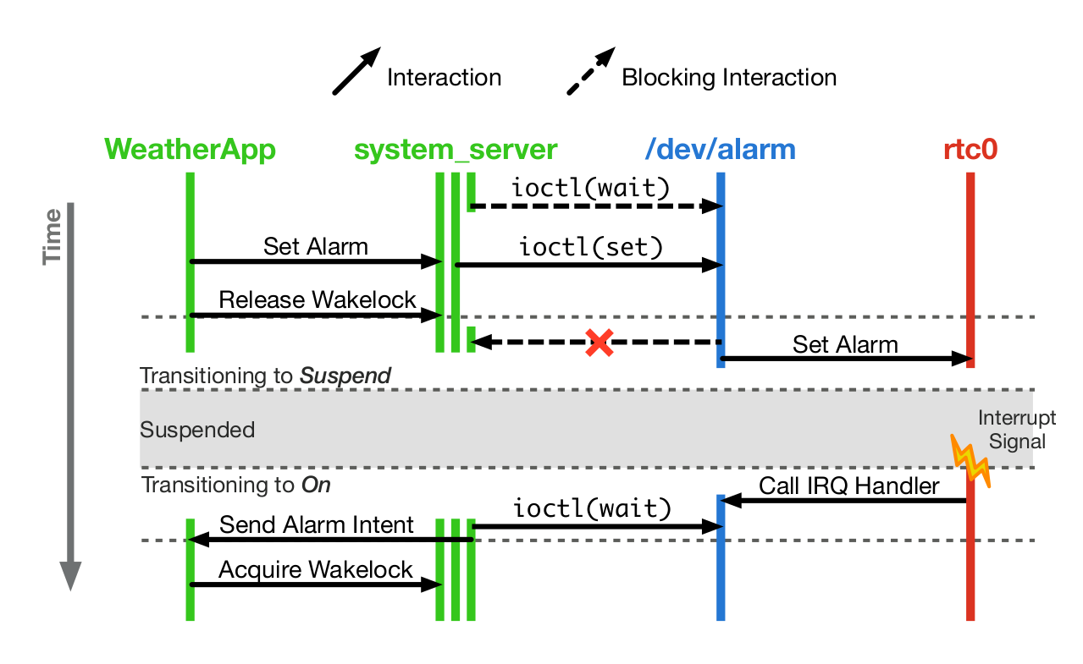
Message sequence of system interactions in Android
“Drowsy Power Management”, Matthew Lentz, SOSP 2015

Slide 14
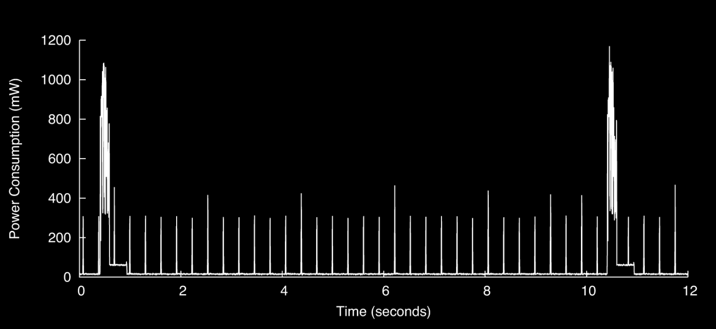
Android background
“Drowsy Power Management”, Matthew Lentz, SOSP 2015

Slide 15
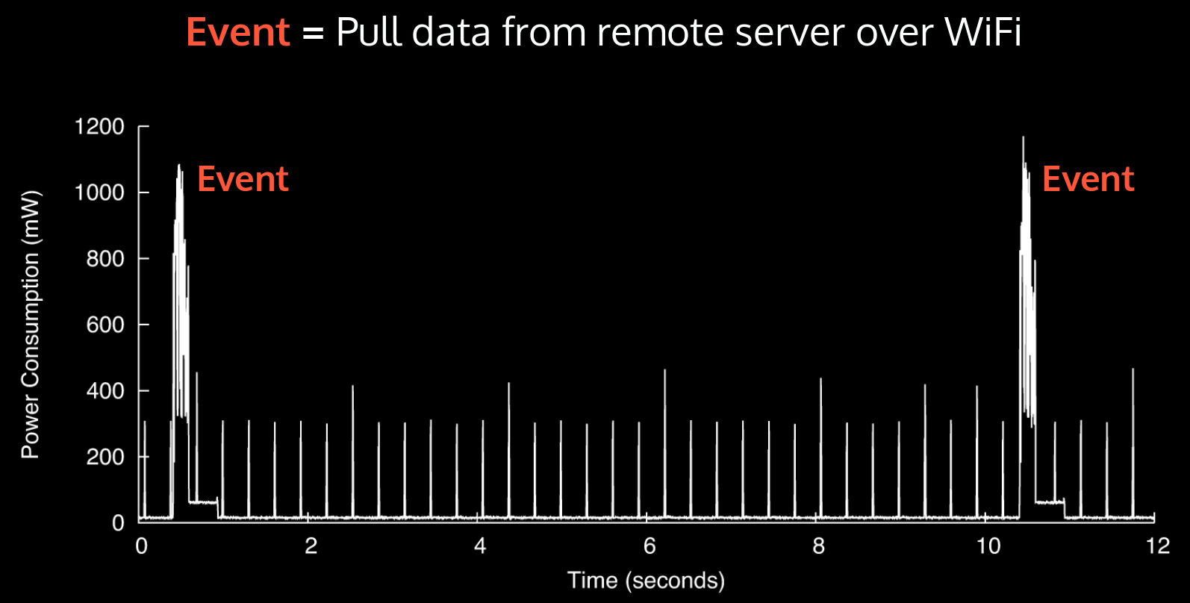
Background Energy Consumption
RF receive

Slide 16
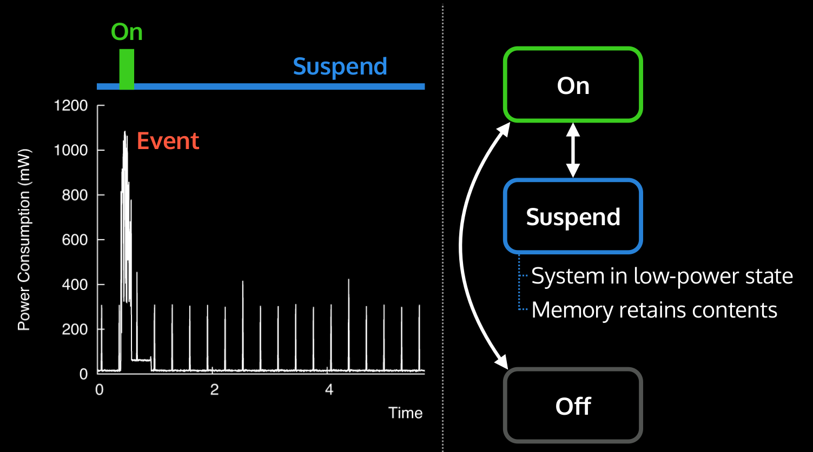
Background Energy Consumption
“Drowsy Power Management”, Matthew Lentz, SOSP 2015

Slide 17
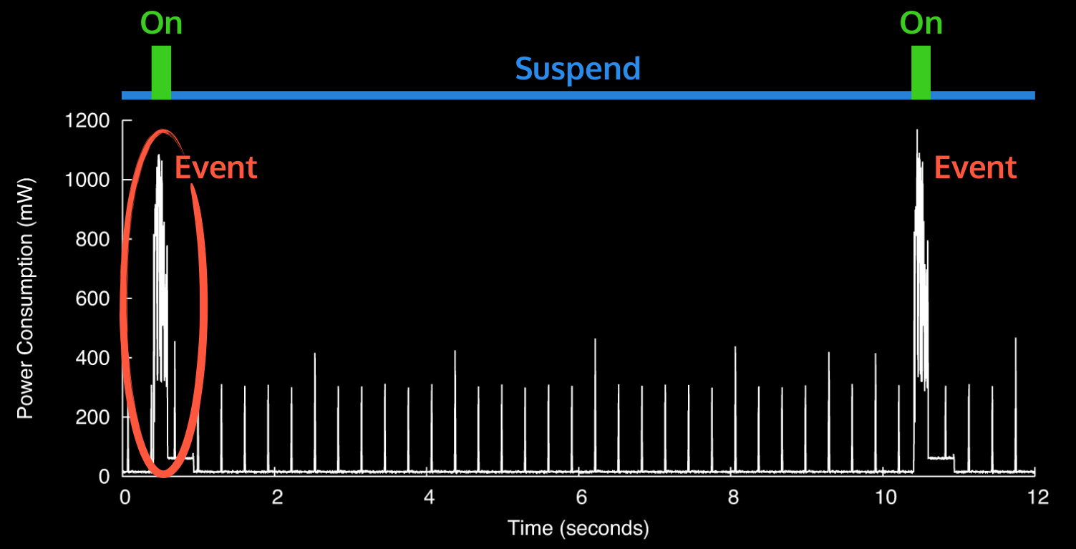
Background Energy Consumption
“Drowsy Power Management”, Matthew Lentz, SOSP 2015

Slide 18
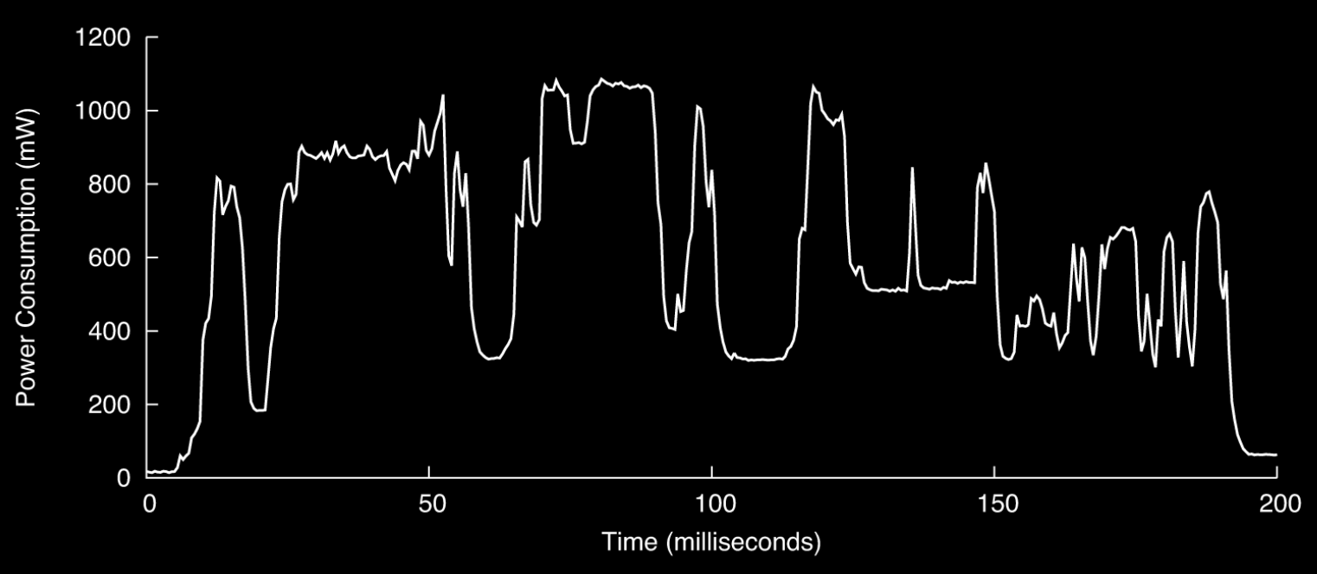
Event
“Drowsy Power Management”, Matthew Lentz, SOSP 2015

Slide 19
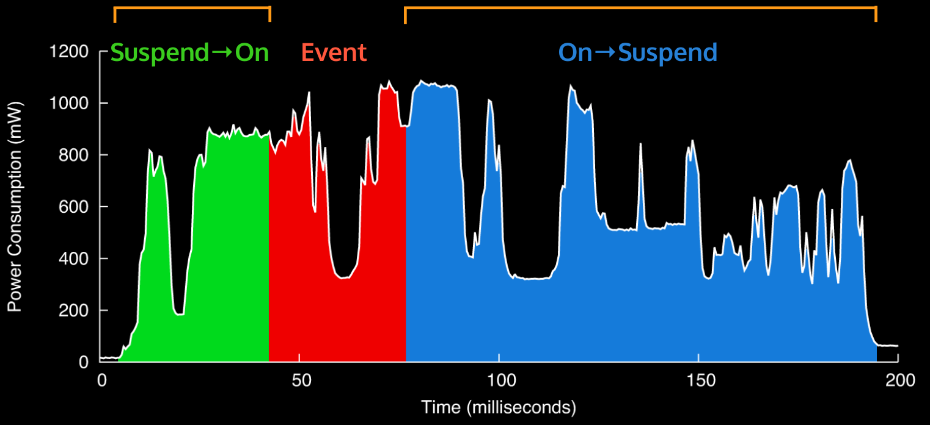
Wake-up and Suspend
“Drowsy Power Management”, Matthew Lentz, SOSP 2015

Slide 20
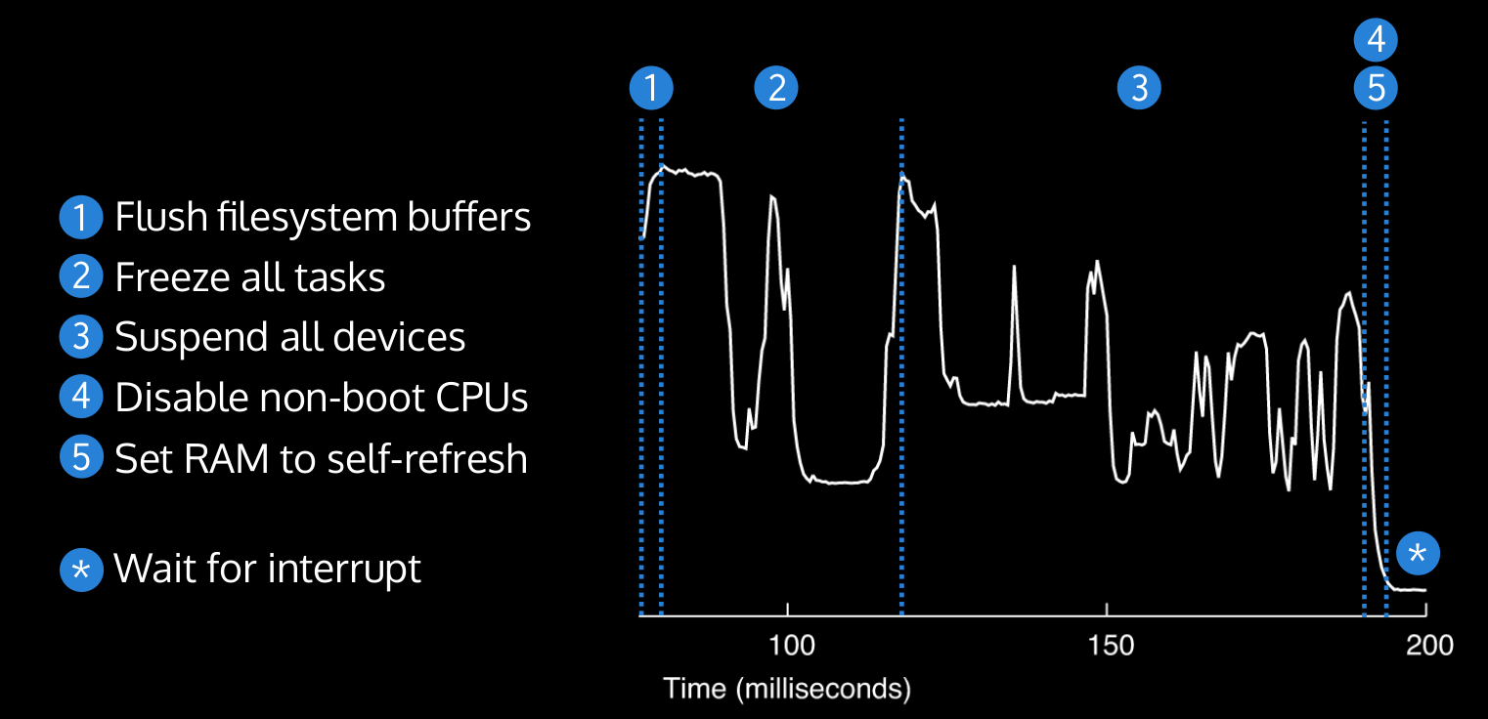
Background Energy Consumption
“Drowsy Power Management”, Matthew Lentz, SOSP 2015

Slide 21
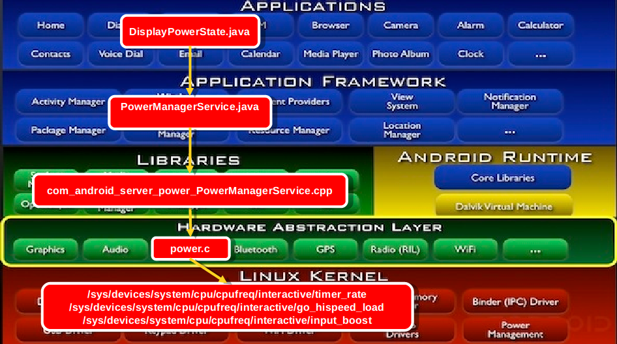
Android power HAL
https://www.slideshare.net/nanik/learning-aosp-android-hardware-abstraction-layer-hal

Slide 22
Android power HAL
A way of providing user’s experience information.
Android Power HINT -> kernel
Ex ) Touch boost, vsync
Sample implementations of power HAL power.$(TARGET_BOARD_PLATFORM).so file can be found (hint: look at the Android.mk’s for these as well as the c code):
hardware/qcom/power
device/asus/grouper/power
device/samsung/manta/power
device/samsung/tuna/power
device/generic/goldfish/power

Slide 23
Real-time scheduling

Slide 24
Real-time scheduling
Determines the order of real-time task executions
Static-priority scheduling
Rate Monotonic
Dynamic-priority scheduling
EDF

Slide 25
Example : RM
 | C | P
T1 | 3 | 20
T2 | 2 | 5
T3 | 2 | 10
T1
T2
T3
Time
5
10
15
20

Slide 26
Example : RM
 | C | P
T1 | 3 | 20
T2 | 2 | 5
T3 | 2 | 10
T1
T2
T3
Time
5
10
15
20

Slide 27
Example : EDF
 | C | D | P
T1 | 3 | 7 | 20
T2 | 2 | 4 | 5
T3 | 2 | 8 | 10
T1
T2
T3
Time
20

Slide 28
Example : EDF
 | C | D | P
T1 | 3 | 7 | 20
T2 | 2 | 4 | 5
T3 | 2 | 8 | 10
T1
T2
T3
Time
5
10
15
20

Slide 29
Example : EDF
 | C | D | P
T1 | 3 | 7 | 20
T2 | 2 | 4 | 5
T3 | 2 | 8 | 10
T1
T2
T3
Time
5
10
15
20

Slide 30


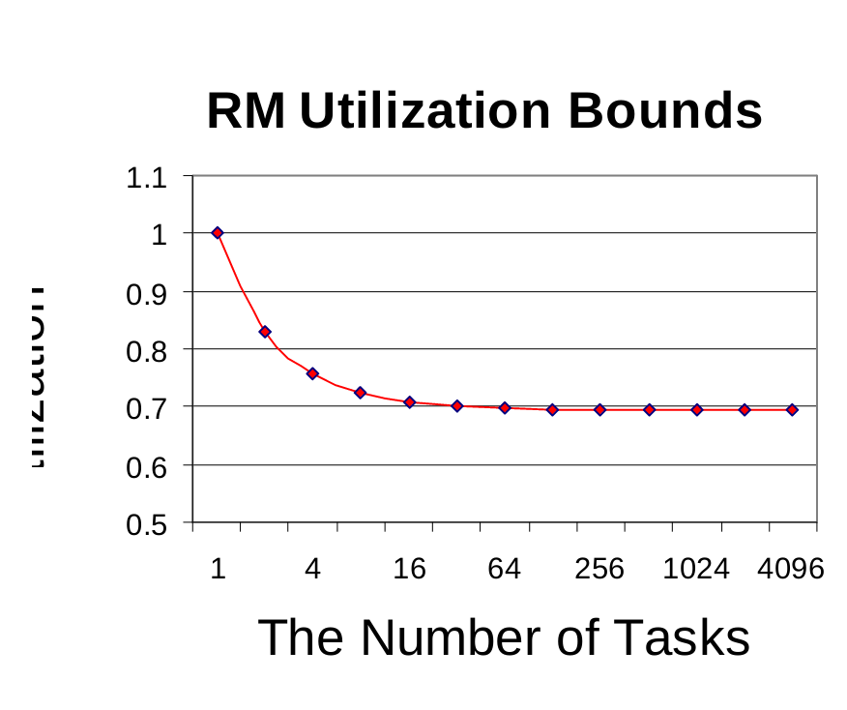
RM Problem – Utilization Bound
n = number of process
Notes:
Example: T1(4,1), T2(5,1), T3(10,1),
∑Ui = 1/4 + 1/5 + 1/10
= 0.55
3 (21/3-1) ≈ 0.78
Thus, {T1, T2, T3} is schedulable under RM

Slide 31
RM vs. EDF
Rate Monotonic
Simpler implementation, even in systems without explicit support for timing constraints (periods, deadlines)
Predictability for the highest priority tasks
EDF
Full processor utilization
Misbehavior during overload conditions
For more details: Buttazzo, “Rate monotonic vs. EDF: Judgement Day”, EMSOFT 2003.

Slide 32
EDF
Can EDF be supported in Linux?
Problem
The kernel is not aware of tasks deadline

Slide 33
Can EDF be supported in Linux?
Can EDF be supported in Linux?
Problem
The kernel is not aware of tasks deadline
Simple Solution
Apps send signal to OS
Start()/End()

Slide 34
Linux’s sched_attr
struct sched_attr {
__u32 size;
__u32 sched_policy;
__u64 sched_flags;
/* SCHED_NORMAL, SCHED_BATCH */
__s32 sched_nice;
/* SCHED_FIFO, SCHED_RR */
__u32 sched_priority;
/* SCHED_DEADLINE (nsec) */
__u64 sched_runtime;
__u64 sched_deadline;
__u64 sched_period;
};

Slide 35
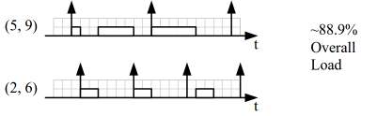
Example
Two tasks with reservations
5ms every 9ms and 2ms every 6ms
https://lwn.net/Articles/398470/

Slide 36
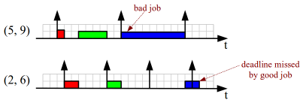
Real world Problem

Slide 37
kernel is not aware of tasks deadline
Use dynamic scheduling deadlines
Constant Bandwidth Server(CBS)
A resource(CPU) reservation mechanism

Slide 38
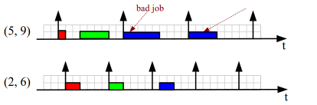
Constant Bandwidth Server(CBS)
Current budget -> 0
Suspended (throttled) till the next activation period
Resource(CPU) reservation

Slide 39
Constant Bandwidth Server(CBS)
Problem
properly dimensioning runtime and reservation period
might be too difficult
What if tasks occasionally need more bandwidth?
e.g., occasional workload fluctuations (network traffic, rendering of particularly heavy frame, etc)
Solution
Use resource over-allocation.
Greedy Reclamation of Unused Bandwidth (GRUB)

Slide 40
SCHED_DEADLINE: It’s Alive!
ARM’s presentation.
ELC North America 17, Portland (OR) 02/21/2017
Near
Experimenting with Android
Reclaiming by demotion towards lower priority class
Capacity awareness (for heterogeneous systems)
Energy awareness (Energy Aware Scheduling for DEADLINE)
And..
Support single CPU affinity
Enhanced priority inheritance (M-BWI most probably)
Dynamic feedback mechanism (adapt reservation parameters to task’ needs)

Slide 41
Reference
https://pdos.csail.mit.edu/6.828/2016/schedule.html
http://web.mit.edu/6.033
http://www.rdrop.com/~paulmck/
“Is Parallel Programming Hard, And If So, What Can You Do About It?”
Davidlohr Bueso. 2014. Scalability techniques for practical synchronization primitives. Commun. ACM 58
http://queue.acm.org/detail.cfm?id=2698990
"CPUFreq and The Scheduler Revolution in CPU Power Management", Rafael J. Wysocki
https://sites.google.com/site/embedwiki/oses/linux/pm/pm-qos
https://intl.aliyun.com/forum/read-916
User-level threads : co-routines
http://www.gamedevforever.com/291
https://www.youtube.com/watch?v=YYtzQ355_Co
Scheduler Activations
https://cgi.cse.unsw.edu.au/~cs3231/12s1/lectures/SchedulerActivations.pdf
https://en.wikipedia.org/wiki/FIFO_(computing_and_electronics)
http://jake.dothome.co.kr/
http://www.linuxjournal.com/magazine/completely-fair-scheduler?page=0,0
https://www2.cs.uic.edu/~jbell/CourseNotes/OperatingSystems/6_CPU_Scheduling.html
"Energy Aware Scheduling", Byungchul Park, LG Electronic
“Update on big.LITTLE scheduling experiments”, ARM
“EAS Update” 2015 september ARM
"EAS Overview and Integration Guide”, ARM TR
“Drowsy Power Management”, Matthew Lentz, SOSP 2015
https://www.slideshare.net/nanik/learning-aosp-android-hardware-abstraction-layer-hal
https://www.youtube.com/watch?v=oTGQXqD3CNI
https://www.youtube.com/watch?v=P80NcKUKpuo
https://lwn.net/Articles/398470/
“SCHED_DEADLINE: It’s Alive!”, ARM, 2017

